Slide 1

1
9
강의를 마치며
1 Next?

Slide 2

Look back..
우리가 다뤘던 내용들
19.
강의를 마치며
딥러닝을 위한 머신 러닝 기초
Feed-forward 네트워크
딥러닝 학습의 Regularization 방법
딥러닝 학습의 최적화 (optimization) 방법
컨볼루션 신경망(convolution neural network; CNN)
순환신경망 (recurrent neural network; RNN, Attention)
트랜스포머 (Transformer) & 자가-주의집중망 (self-attention)
Large-scale의 Pretrained Transformer (GPT, BERT)
Deep Generative 모델들
Auto-regressive / Sequence-to-sequence / Auto-encoder / Embedding
Flow & IAF 모델
Latent Variable Model(Variational Inference; VAE)
Implicit Models(GAN)
Metric Learning
Reinforcement Learning & Deep RL
Meta-learning
Production을 위한 기본적인 Research Engineering 기법 소개

Slide 3
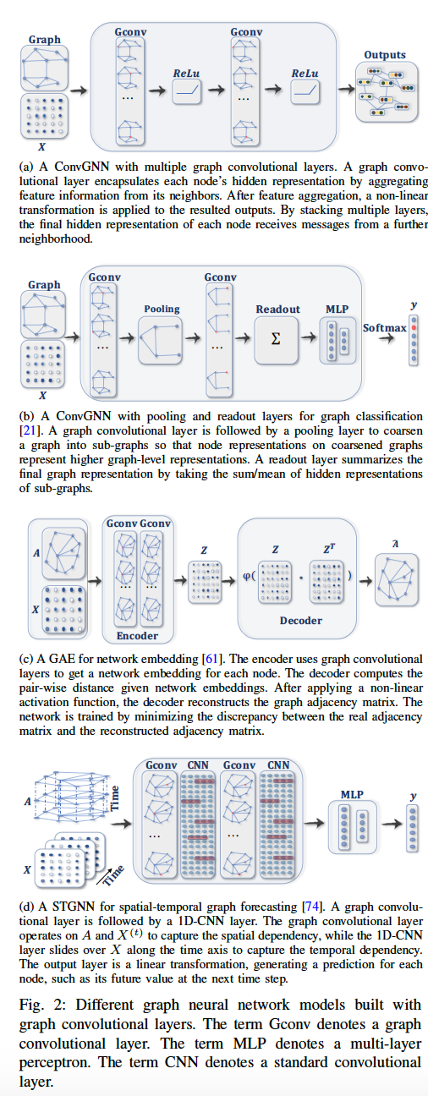
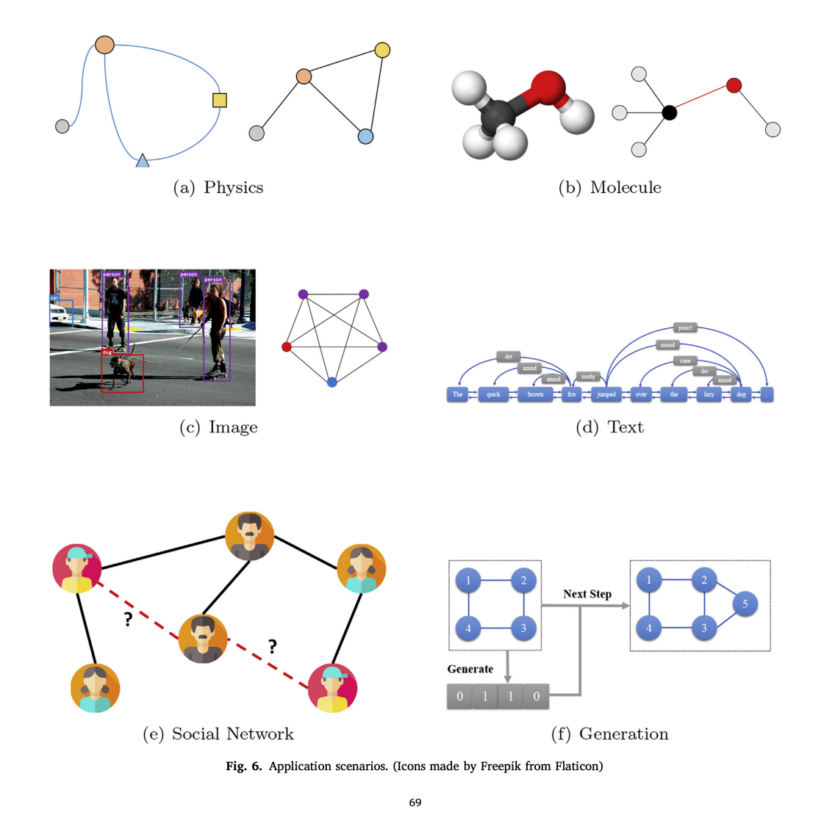
더 공부하고 싶다면?
추천하는 토픽 – Graph Neural Network (GNN)
19.
강의를 마치며
Zhou, Jie, et al. "Graph neural networks: A review of methods and applications." AI Open 1 (2020): 57-81.
Wu, Zonghan, et al. "A comprehensive survey on graph neural networks." IEEE transactions on neural networks and learning systems 32.1 (2020): 4-24.

Slide 4
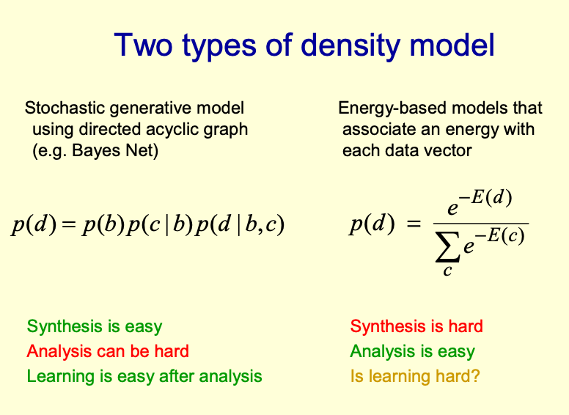
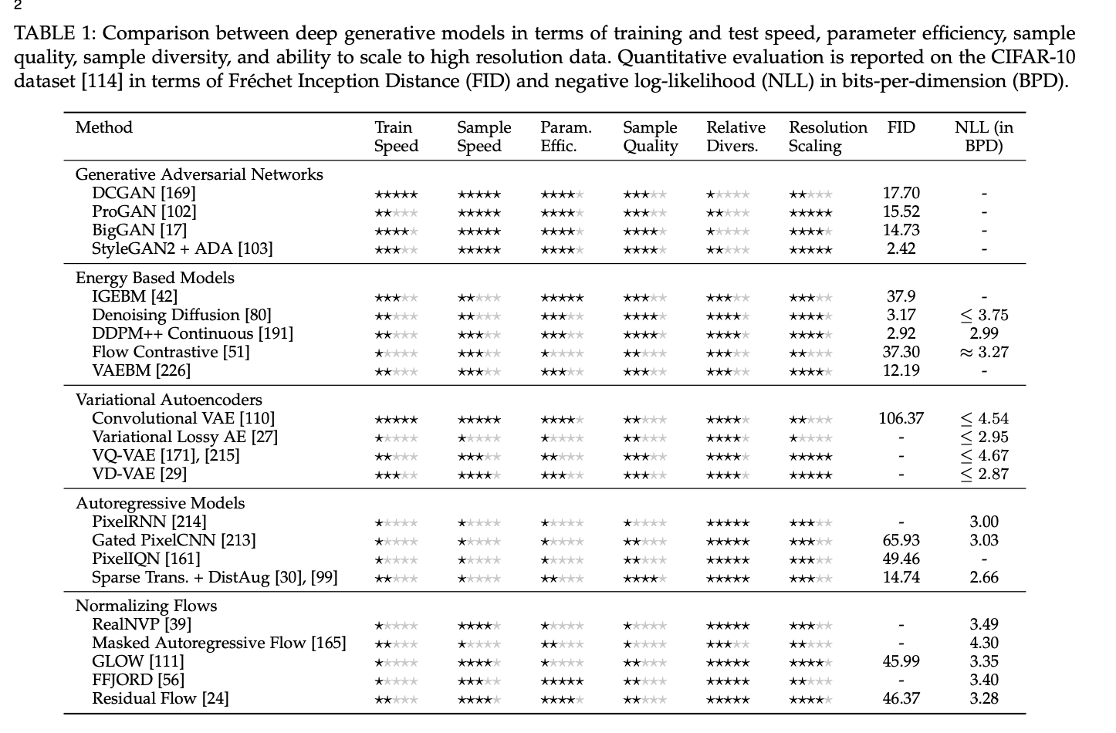
더 공부하고 싶다면?
추천하는 토픽 – Energy-based Model
19.
강의를 마치며
https://www.cs.toronto.edu/~hinton/talks/EBMtalk.pdf
Bond-Taylor, Sam, et al. "Deep Generative Modelling: A Comparative Review of VAEs, GANs, Normalizing Flows, Energy-Based and Autoregressive Models." arXiv preprint arXiv:2103.04922 (2021).

Slide 5
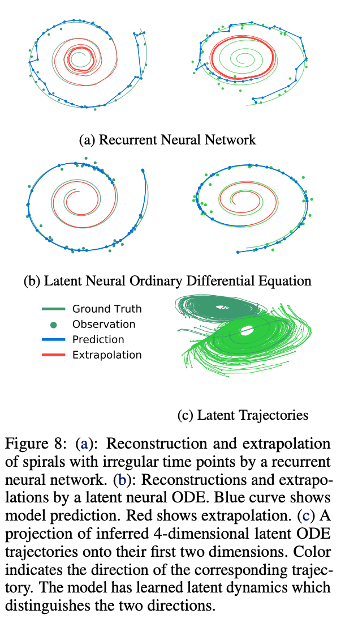
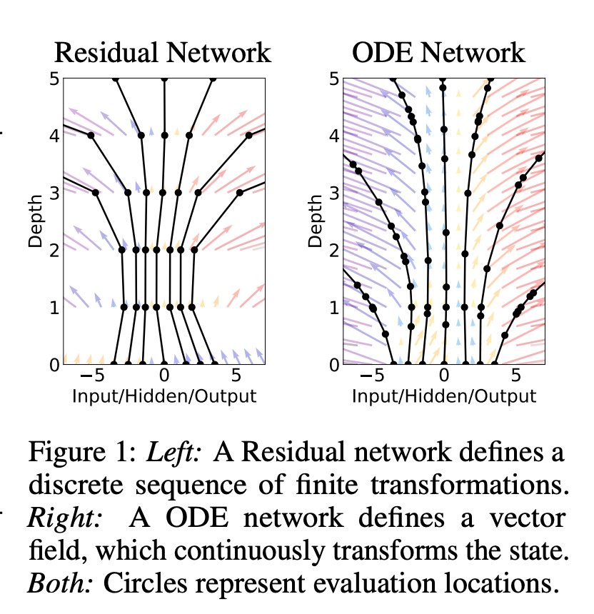
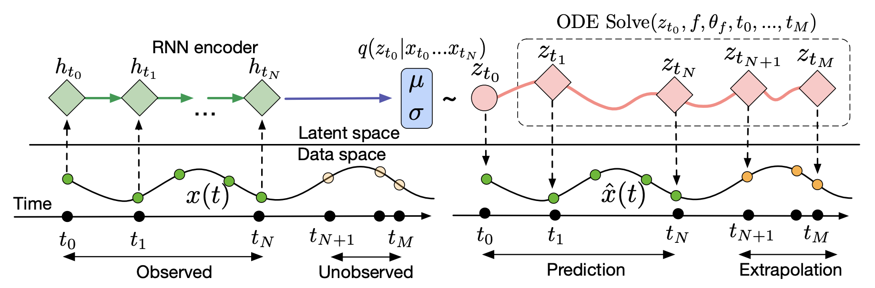
더 공부하고 싶다면?
추천하는 토픽 – Neural ODE
19.
강의를 마치며
Chen, Ricky TQ, et al. "Neural ordinary differential equations." arXiv preprint arXiv:1806.07366 (2018).

Slide 6
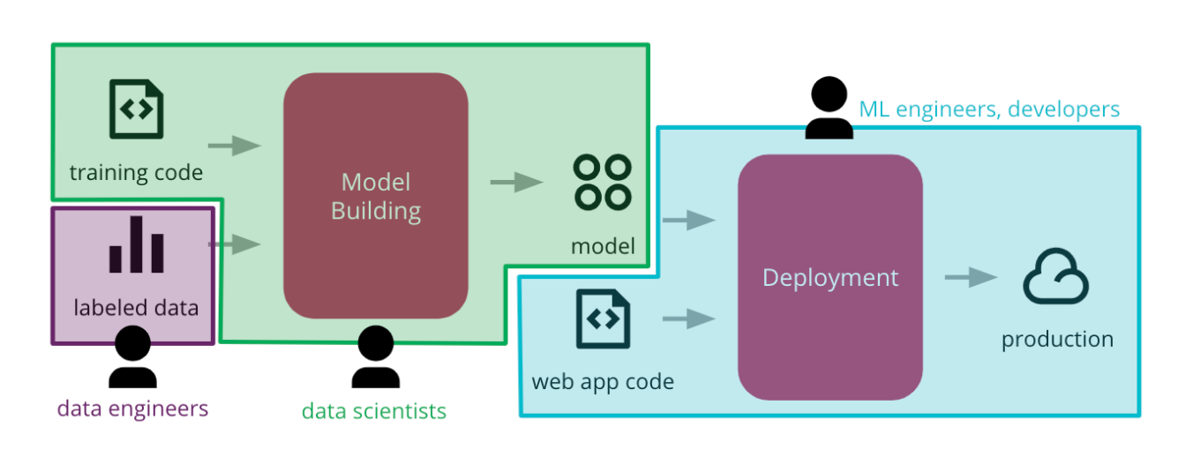
What’s your Next?
19.
강의를 마치며
https://martinfowler.com/articles/cd4ml.html

Slide 7
End of Lecture !
19.
강의를 마치며
고생 많으셨습니다 :)

